Slide 1

E-Commerce Product Categorization System
SHUBHAM GOYAL

Slide 2
PROBLEM STATEMENT
In the rapidly evolving world of eCommerce, accurate product categorization is crucial for ensuring seamless customer experiences, reducing search friction, and increasing product discoverability. However, the sheer volume of diverse products poses a significant challenge. Current classification systems struggle to handle ambiguities, unconventional naming conventions, and multi-language data. This hackathon aims to address these challenges by inviting participants to create innovative solutions that enhance product categorization efficiency, accuracy, and scalability.
Develop a text classification model that categorizes products with maximum accuracy based on description of the product.

Slide 3
PROBLEM SOLVING APPROACH
Since we will be working with textual description, this is an NLP Problem. Here are the steps involved
Load the dataset
Perform EDA(Exploratory Data Analysis) to extract valuable business insights
Using NLTK for data preprocessing and feature engineering
Transform Textual description to numerical features
Train and evaluate various suitable machine learning models
Fine tune them if neccessary using Hyperparameter tuning
Get our predictions
Finally, we will compare the various models to get the best performing model

Slide 4
INSIGHTS
The highest selling category is :
Clothing
Jewelry
Least selling categories are:
Tools & hardware,
Toys & School Supplies,
Pens & Sationary
Baby Care
Bags Wallets Belts

Slide 5
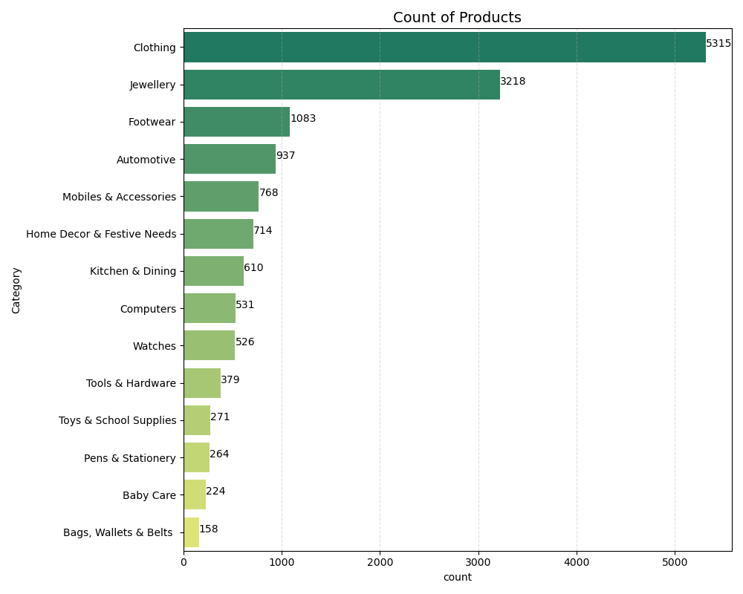

Slide 6
Model used:
Logistic Regression
MultiNomialNB
RandomForestClassifier
Deep Learning Approach (LSTM)

Slide 7
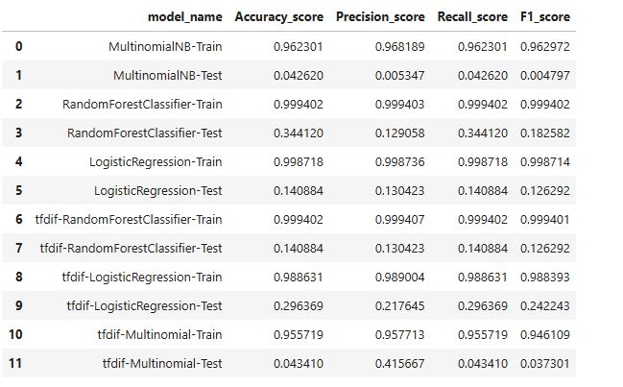

Slide 8
Business Values by this solution:
The business value of product categorization can be significant, especially in e-commerce or large retail environments. Here’s how it adds value across various aspects...

Slide 9
Improved User Experience and Searchability
By accurately categorizing products based on their descriptions, you improve the searchability of the products. Customers can filter and search products more efficiently when they are properly categorized. This can significantly enhance the customer journey.

Slide 10
Streamlined Inventory Management
Categorizing products based on descriptions ensures that items are placed in the correct categories in the system, which can simplify inventory management. You can automatically group similar products together, making it easier to track and manage stock levels.

Slide 11
Increased Operational Efficiency
Automating the categorization of products based on their descriptions removes the need for manual categorization, reducing human error and freeing up resources. This boosts operational efficiency by automating what would otherwise be a tedious manual task.

Slide 12
Personalized Recommendations and Targeting
Accurate categorization based on product descriptions can enhance personalized recommendations. If products are well-categorized, the system can suggest related products more effectively, increasing customer engagement and sales.

Slide 13
Scalability for Growth
As your e-commerce platform grows and more products are added, the system can scale the categorization process automatically without manual intervention, ensuring that new products are categorized quickly and accurately.

